Slide 1

Data Structures in Python

Slide 2

Agenda
Introduction to Linked Lists
Singly Linked List
Doubly Linked List
Linked List Operations (insert, delete, traverse)
Reversal of Linked List
Practice Problems

Slide 3
Unit Overview
This unit introduces the fundamental concepts of Trees, a hierarchical data structure widely used in computer science. Students will understand tree terminology, different types of trees, and how trees are represented in memory.

Slide 4
Introduction to Trees
A Tree is a hierarchical, non-linear data structure consisting of nodes connected by edges.
Unlike arrays and linked lists (linear structures), trees store data in a hierarchy.
Real-Life Examples
File system (folders & subfolders)
Organization hierarchy
Family tree
Decision trees
HTML DOM structure

Slide 5
Tree Terminology
🔹 Leaf Node
Node with no children.
🔹 Internal Node
Node with at least one child.
🔹 Edge
Connection between two nodes.
🔹 Height of Tree
Longest path from root to leaf.
🔹 Depth of Node
Number of edges from root to that node.
Understanding terminology is very important.
🔹 Root
Topmost node of the tree.
🔹 Parent
A node that has children.
🔹 Child
A node connected below another node.
🔹 Siblings
Nodes sharing the same parent.

Slide 6
Tree Representation in Python
Trees are usually represented using Nodes and References.
Basic Node Structure
class Node:
def __init__(self, data):
self.data = data
self.left = None
self.right = None
This structure is mainly used for Binary Trees.

Slide 7
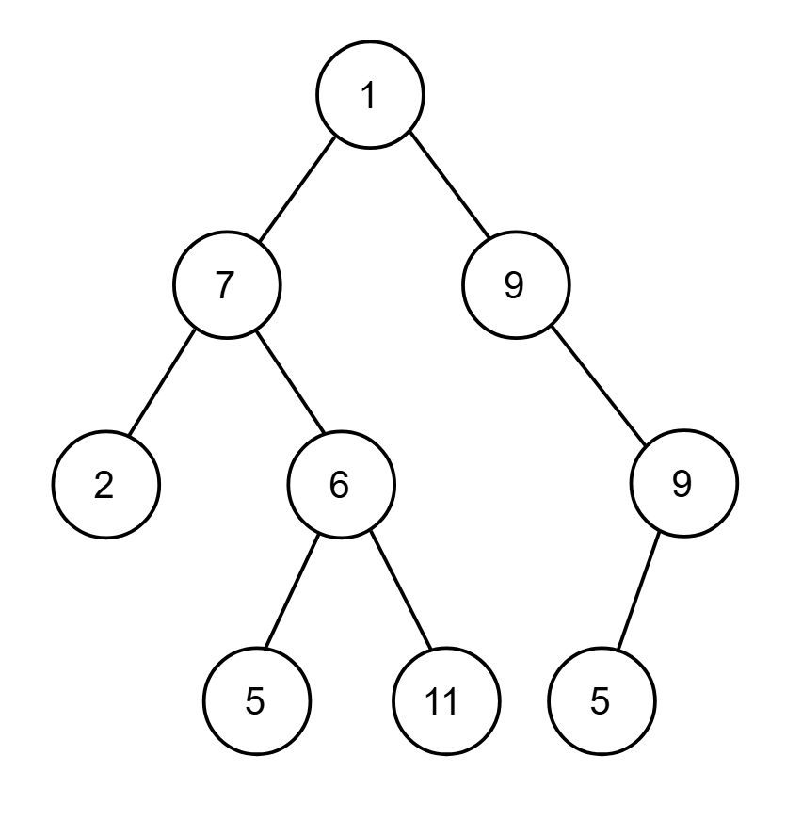
Binary Tree
A Binary Tree is a tree where each node has at most two children:
Left child
Right child
10
/ \
5 20

Slide 8
Tree Traversals
Traversal means visiting every node in a specific order.
1. Inorder Traversal (LNR)
Left → Node → Right
def inorder(root):
if root:
inorder(root.left)
print(root.data)
inorder(root.right)
Used in BST to get sorted output.

Slide 9
Tree Traversals
2. Preorder Traversal (NLR)
Node → Left → Right
def preorder(root):
if root:
print(root.data)
preorder(root.left)
preorder(root.right)
Used to copy tree structure.

Slide 10
Tree Traversals
3. Postorder Traversal (LRN)
Left → Right → Node
def postorder(root):
if root:
postorder(root.left)
postorder(root.right)
print(root.data)
Used for deleting trees.

Slide 11
Tree Traversals
4. Level Order Traversal
Visit nodes level by level. Uses Queue (BFS approach)
from collections import deque
def level_order(root):
if not root:
return
queue = deque([root])
while queue:
node = queue.popleft()
print(node.data)
if node.left:
queue.append(node.left)
if node.right:
queue.append(node.right)

Slide 12
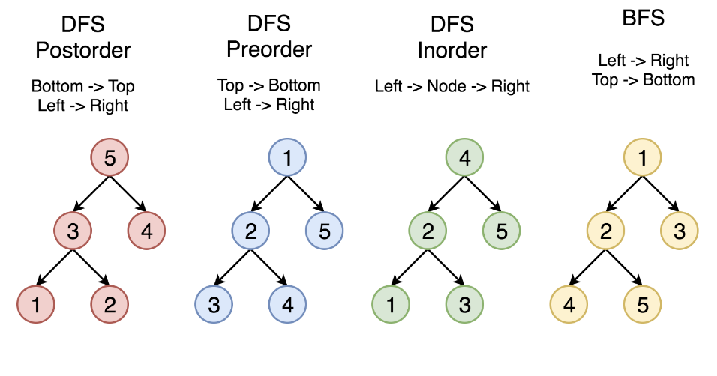
Tree Traversals

Slide 13
Types of Binary Trees
Full Binary Tree
Every node has either 0 or 2 children.
Complete Binary Tree
All levels are completely filled except possibly the last level, filled from left.
Perfect Binary Tree
All internal nodes have 2 children and all leaves are at same level.
Balanced Binary Tree
Height difference between left and right subtree ≤ 1.

Slide 14
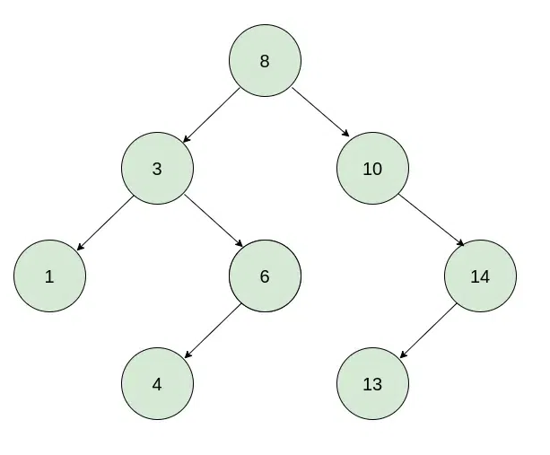
Binary Search Tree (BST)
A Binary Search Tree follows this rule:
Left subtree < Root
Right subtree > Root
10
/ \
5 20

Slide 15
BST Operations
1. Insert
def insert(root, key):
if not root:
return Node(key)
if key < root.data:
root.left = insert(root.left, key)
else:
root.right = insert(root.right, key)
return root
Time Complexity:
Average: O(log n)
Worst case: O(n)

Slide 16
BST Operations
2. Search
def search(root, key):
if not root or root.data == key:
return root
if key < root.data:
return search(root.left, key)
return search(root.right, key)

Slide 17
BST Operations
3. Delete (Concept)
Three cases:
Node is a leaf
Node has one child
Node has two children → Replace with inorder successor

Slide 18
Real-World Applications
Database indexing
File systems
Expression trees
Decision making systems
Auto-complete systems
Routing algorithms

Slide 19
Problem Solving Section
Create a binary tree manually.
Perform all four traversals.
Insert elements in BST.
Search for a value.
Find height of tree.
Check if tree is balanced.
Delete a node from BST.

Slide 20
Key Outcomes
✔ Tree terminology
✔ Binary Tree structure
✔ Tree traversals (Inorder, Preorder, Postorder, Level Order)
✔ Types of trees
✔ Binary Search Tree (BST)
✔ BST operations
✔ Time complexity analysis

Slide 21
Thank You!

